Slide 1


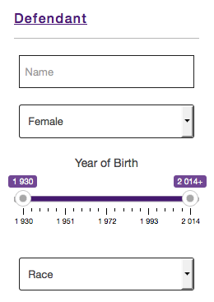

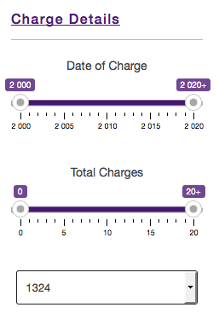
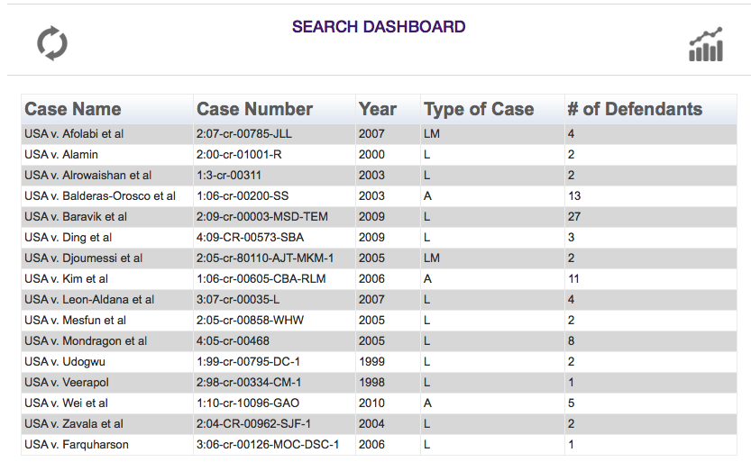
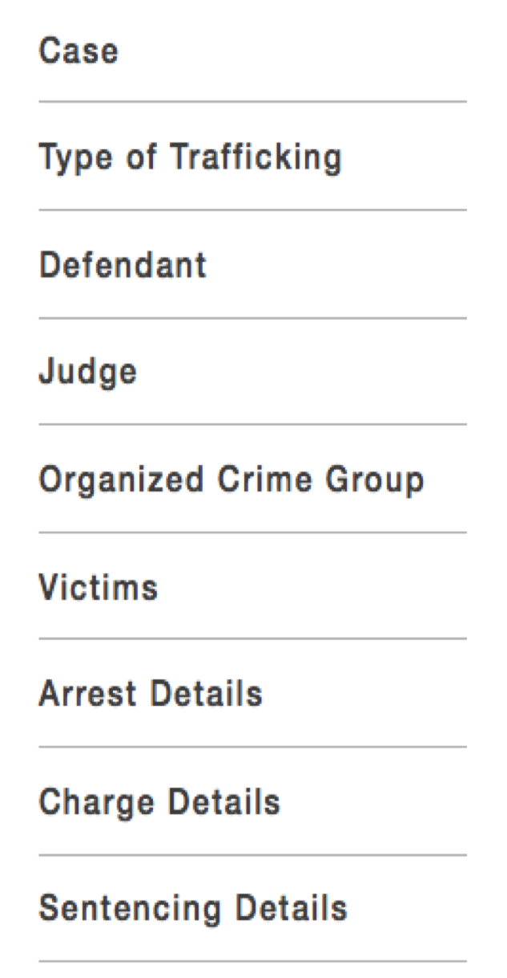
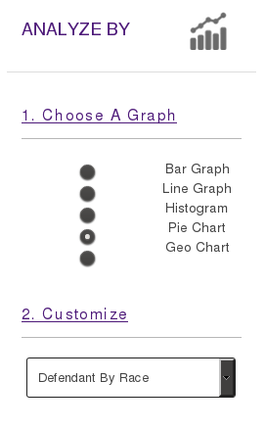
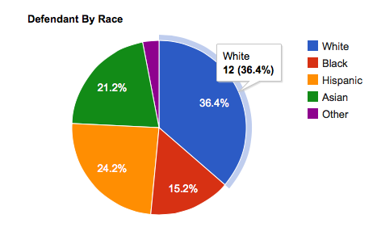
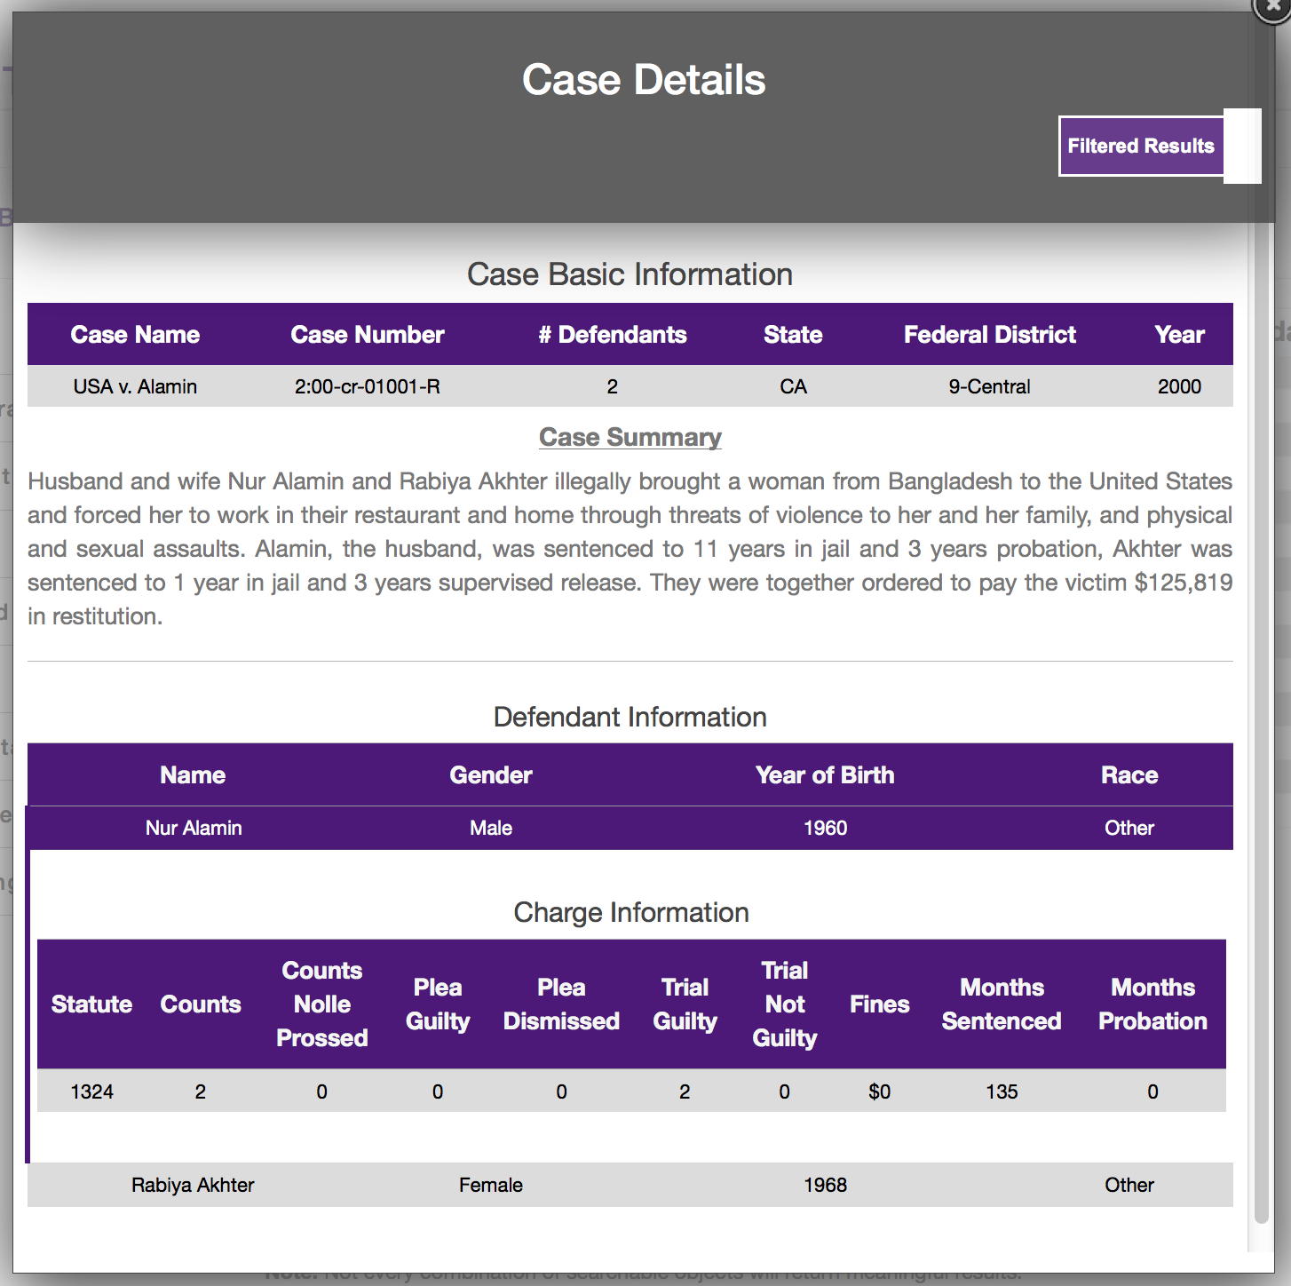
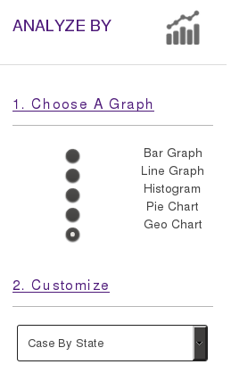
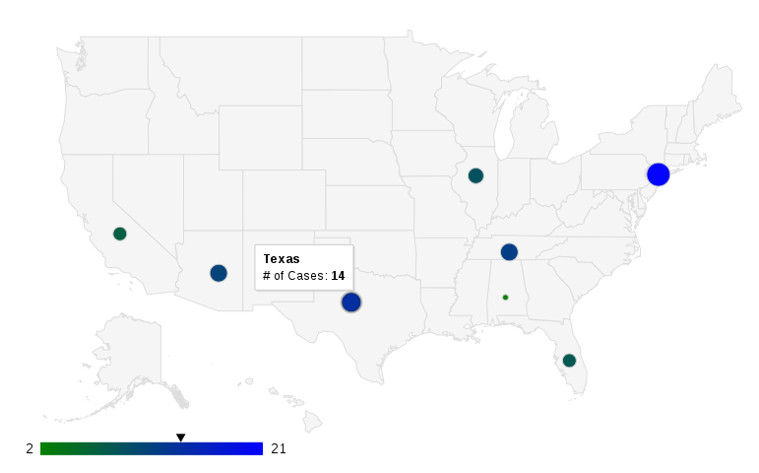
Judge Frog:
Comprehensive Human Trafficking Data Search and Analysis
Brice Boula, Collin Duncan, David Tomlinson, Landon Westrom
Advisors: Dr. Vanessa Bouché, Dr. Donnell Payne
Problem
The issue of human trafficking has sparked interest from the government, academicians, non-government organizations, and the private sector
With today’s available resources on human trafficking it is difficult to examine:
  How interconnected is organized crime with human trafficking in the United States
  What types of organized crime groups engage in human trafficking
  The possibility to prevent individuals from engaging in organized crime, and specifically human trafficking
STEP 1
The web application provides users with the ability to search based on 47 case variables, e.g.; “Female” defendants that are charged under statute “1324”
STEP 2
The search shows 16 cases that involve “Female” defendants charged under statute “1324”
Search Panel
Allows user to search the database for thousands of cases and their individual defendants
Search by 47 different case specific variables and view applicable results in table
Select row in results table to display detailed case information
Analyze Panel
Allows user to visualize specified data from all or selected cases
Choose from 5 types of graphs and select the independent and dependent variables to dynamically generate an interactive graph
Solution
Our project addresses the issues stated in the problem by:
Creating a comprehensive database to store information on federal human trafficking cases
Developing tools for administrators to maintain the database
Developing interface for administrators to maintain users
Providing a robust search function allowing users to query and filter the database
Displaying dynamically generated graphs that allow analyses to be performed on these cases
STEP 4
STEP 3
After reviewing the case details the user can perform further analysis using with graphing interface
The user can choose any of the 16 selected cases and review all details or filtered details based on the search criteria given. The modal window displays details of the case chosen.
Admin Panel
User permissions:
  Admin: allowed full to admin panel
  Research Assistant (RA): allowed access to create and edit
Case entry is performed via single-case insertion or administrator batch upload
Allows administrators to review a case after case has been inserted or edited
Case editing and deletion performed solely by admins
Defendant By Race
Database Structure
Comprehensive database developed with MySQL
Stores case information consisting of judge, federal district location, defendant, and victims information
Each defendant contains information regarding their arrest, charges, sentencing and organized crime involvement
Database contains multiple tables allowing assistants to insert cases and receive administrator approval before appending new information to the working dataset
Cases By State
Results and Conclusions
Successfully developed a highly efficient interface for searching and analyzing human trafficking cases
Provided ability for admins to maintain dataset to add to project longevity
Experienced real world interactions with clients and working with clients’ requirements
Acknowledgments
This project was developed in support of grant NIJ-2013-3457 from the National Institute of Justice to TCU Political Science faculty member, Dr. Vanessa Bouché, in order to study organized crime's involvement in human trafficking in the United States. We would like to especially thank Dr. Bouché for her time spent defining the project requirements and providing the human trafficking data used in the project. We would also like to give a special thanks to Dr. Payne for her incredible patience and guidance throughout this project.
Web Application
Provides a user friendly web interface for the user to search thousands of human trafficking cases
Interfaces with MySQL database to search, analyze, and maintain a working dataset
Will allow public access at no cost
References
Albanese, Jay S., et al. Organized crime in America. Anderson Publishing Company, 1996.
CakePHP Cookbook – http://book.cakephp.org/2.0/en/index.html
Gozdziak, Elzbieta M., and Elizabeth A. Collett. "Research on human trafficking in North America: A review of literature.” International Migration 43.1‐2 (2005): 99-128.
MySQL Developer Zone – http://dev.mysql.com/
National Institute of Justice – http://www.nij.gov/topics/crime/human-trafficking/pages/welcome.aspx
Richard, Amy O. International trafficking in women to the United States: A contemporary manifestation of slavery and organized crime. Bureau of Intelligence and Research (state) Washington DC, 1999

